Slide 1
SALES DATA ANALYSIS USING QUERIES IN MY SQL
DONE BY PEDHADA VARUN

Slide 2
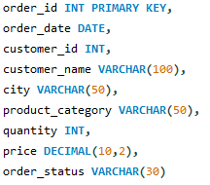

DATASET DESCRIPTION
TABLE 1 - SALES TABLE 2 – CUSTOMERS1

Slide 3

Query 1:Find all order from Delhi and display them ordered by price in descending order from sales table.
Filter order from delhi
Sorts them by highest price first

Slide 4

Query 2:Calculate the total sales revenue for each city from sales table.
Groups data by city
Calculates total sales for each city

Slide 5

Query 3:Display the top 5 highest priced orders after skipping the first 2 orders from sales table.
Shows 5 ordes after skipping first 2 highest priced orders

Slide 6

Query 4:Dense Rank all orders based on the highest order price from sales table.
Assigns rank based on highest price.
order value without skipping.

Slide 7

Query 5:Find orders where the price is greater than the average price of all orders from sales table.
Finds orders where price is greater than average price

Slide 8
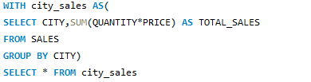
Query 6: Find cities where total sales revenue is greater than 5000 using a CTE from sales table.
Creates temporary result city_sales
Shows cities with sales greater than 5000

Slide 9

Query 7:Retrieve order details along with customer information by Inner join the Sales table and Customers1 table.
Combines sales table and customers1 table
Shows order details with customer information which are matching in both tables

Slide 10

Query 8:Create a view to display all delivered from the sales table.
Creates a view for all delivered orders
Can be queried like a table

Slide 11
THANK YOU

